Slide 1
DATA JOURNALISM · SINGAPORE POLITICS · 1955–2025
The Quiet Revolution
How Singapore's Opposition Is Winning Without Winning
Lucas Sam · February 2026
Analysis based on 32 constituencies with available historical data.
Notes:
Okay so — seventy years of election data, twelve slides, fifteen minutes.
I promise it's more interesting than it sounds. Let's go.

Slide 2
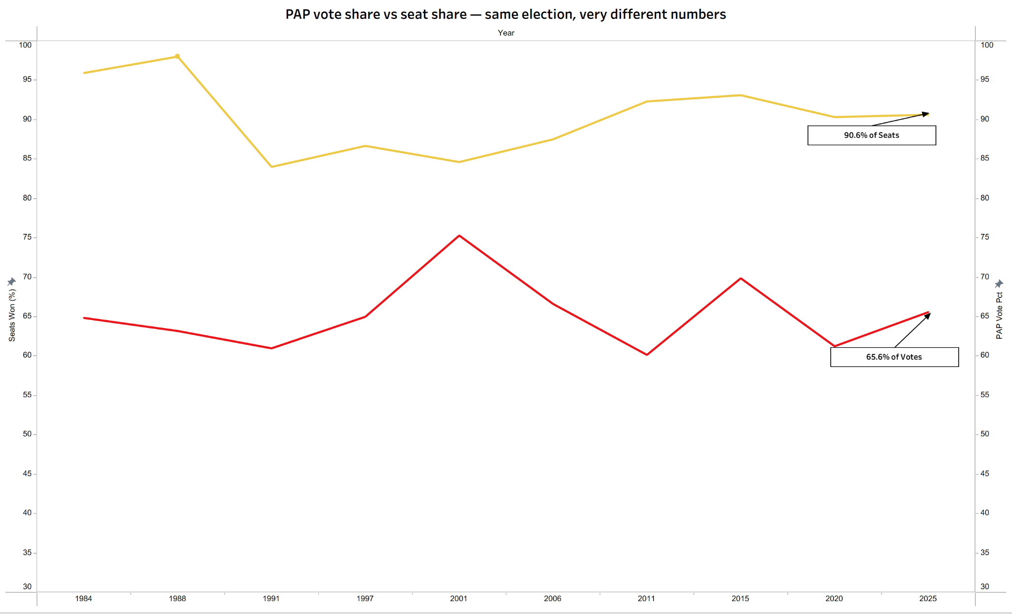
The votes are moving, the seats are not
Notes:
I want to start with something simple. Two lines on a chart.
One line tracks how many votes PAP gets. The other tracks how many seats they win.
Now — if I told you a party got 65.8% of the votes, how many seats would you expect them to win? Maybe 65%, 68%, somewhere around there, right?
PAP won 90.6% of seats. You can see both numbers annotated directly on the chart — 65.6% of votes, 90.6% of seats.
That is not a rounding error. That is a 25 percentage point gap between what Singapore voted for and what ended up in Parliament.
Show of hands — how many of you actually knew this gap was this big?
[Pause. Acknowledge.]
Yeah. Most people don't. And that's kind of the whole point of this analysis.
Now before you say — "wah, must be the opposition too weak lah" — let me show you whether that's actually true. Because the data has a very different answer.

Slide 3
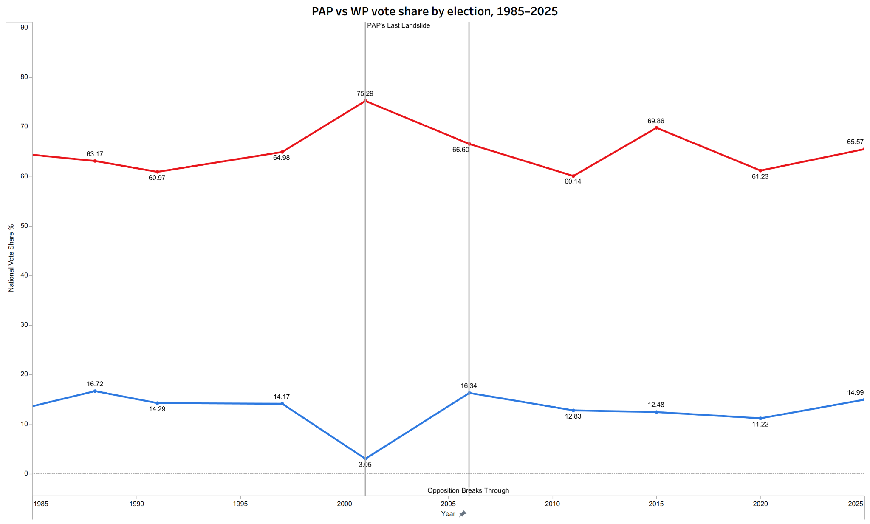
The opposition vote has been growing for 40 years
75% Vote Share
PAP peak vote in recent elections in 2001
60% Vote Share
PAP’s low in 2011
16% Vote Share
WP’s Breakthrough in 2006
Notes:
Look at the red line. PAP's national vote share. 75% in 2001 — their peak. Down to 60% in 2011 — their lowest in modern history. That was the year they lost Aljunied and called it a "watershed election." Which, to be fair, it was.
Now look at the blue line at the bottom. That's WP. Starting from near zero, climbing steadily, reaching 14.9% nationally in 2025.
14.9% sounds modest, I know. But here's the context — WP only contested 8 seats out of 97. Their national share is diluted by all the seats they didn't even show up for.
In the seats they actually fought? They averaged 50.5%. We'll come back to that number. It's the most important number in this entire deck.
The key point here is simple. Forty years of consistent upward movement. This is not Singaporeans kpkb-ing and then voting PAP anyway. This is a real, structural shift.

Slide 4
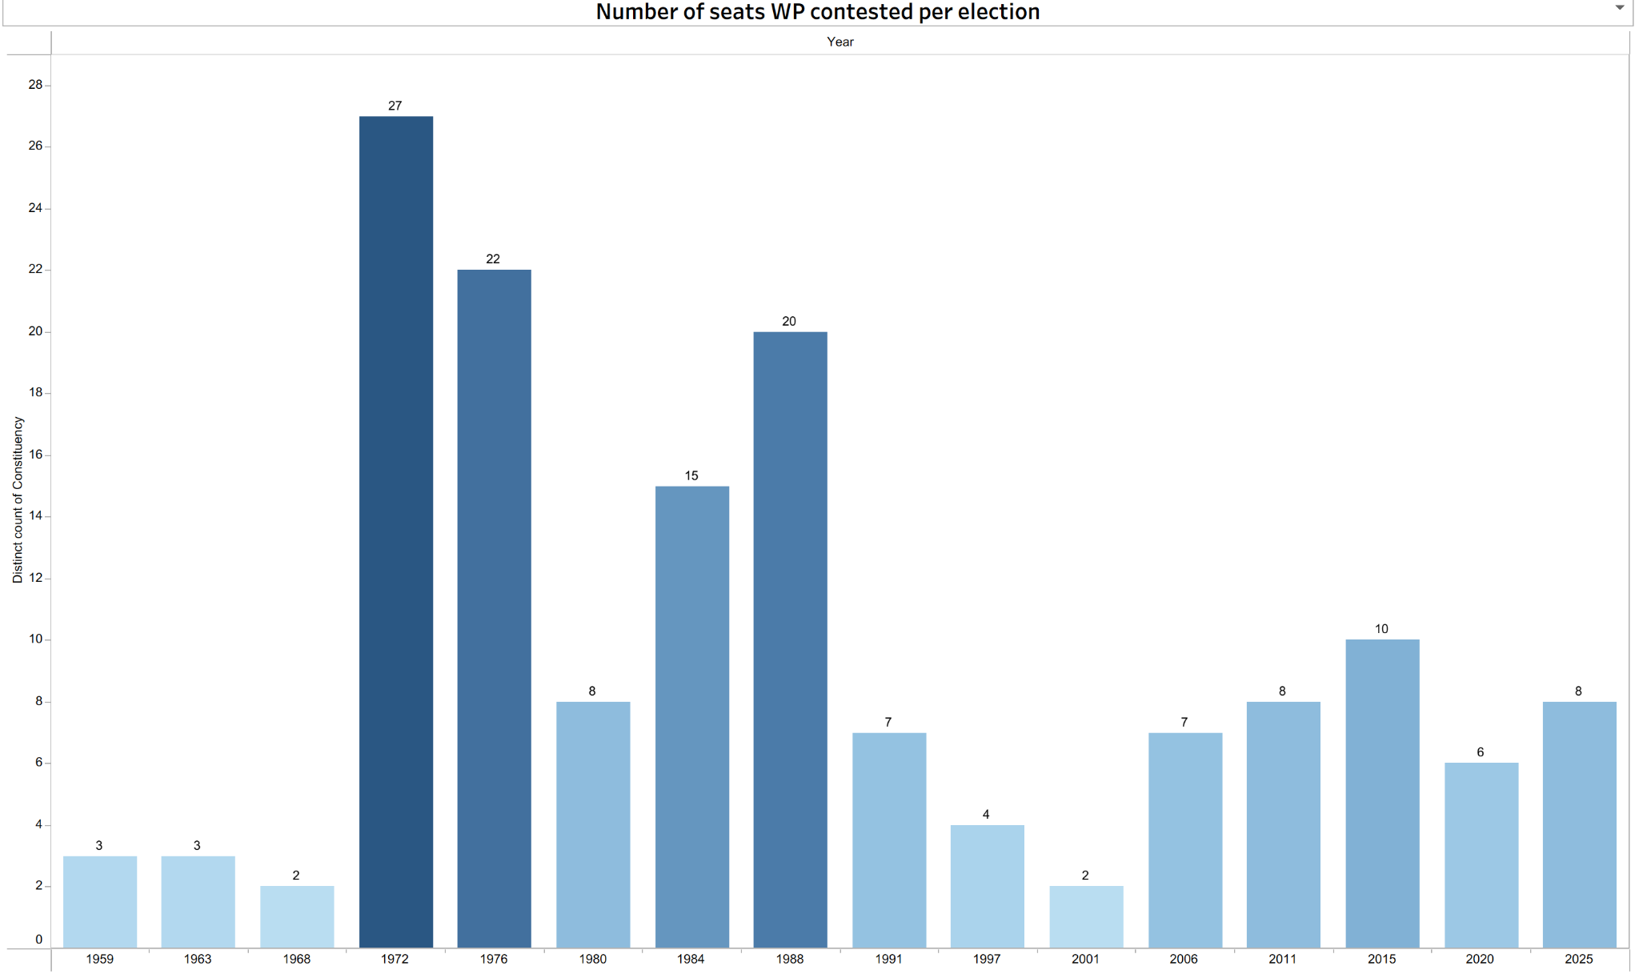
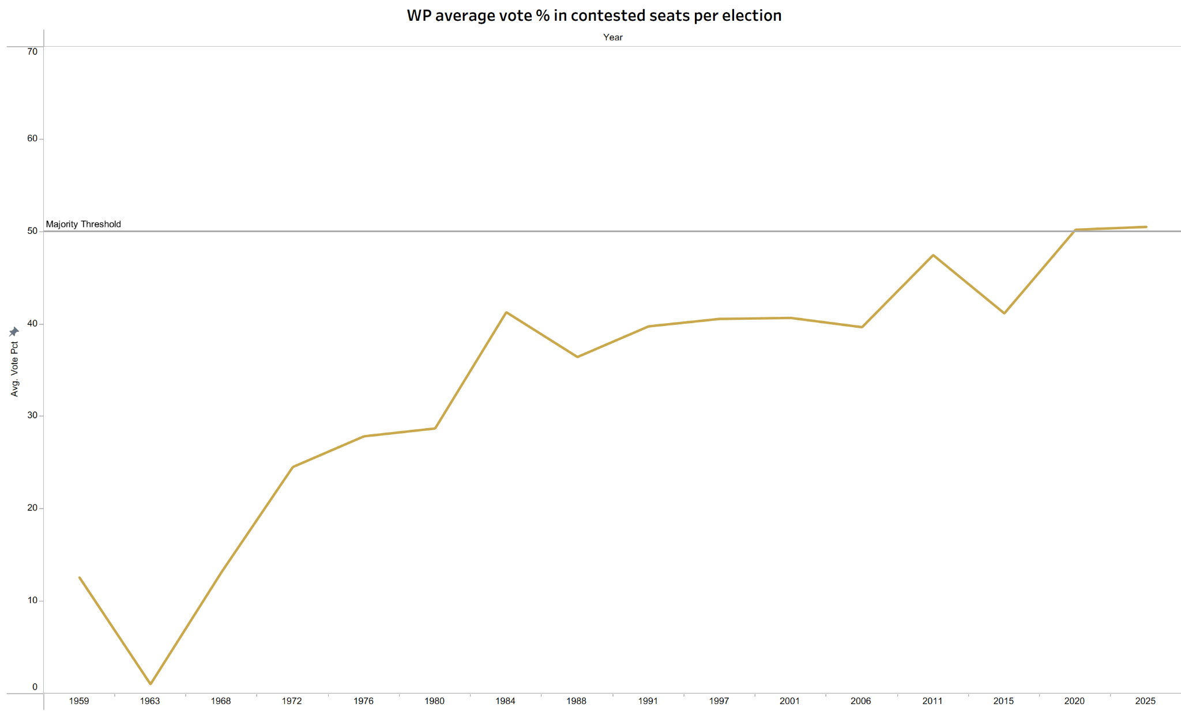
WP contests fewer seats than ever — and wins more of them
Notes:
1972 — WP contested 27 seats. 2025 — they contested 8.
Quick question. Does this look like a party growing or a party giving up?
[Take one response.]
If you're looking at the left chart only — looks like giving up, right? But look at the right chart. Their average vote share in those contested seats has been climbing for decades and just crossed the 50% majority threshold.
Fewer fights. Better results. The question is — if they're getting 50.5% in contested seats, why aren't they winning more? Next slide.

Slide 5
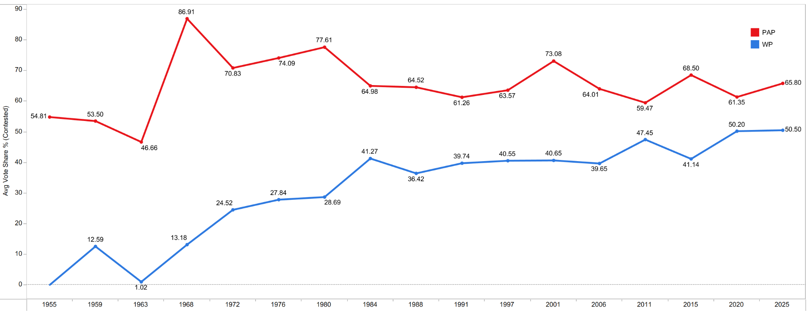
The votes are there, the teams are not
50.5% Average
WP’s average vote share across all seats that they contested in 2025.
Real barrier: fielding teams
GRCs require 3–6 credible candidates per contest. That’s a pipeline problem - note a votes problems
The Gap is Closing
WP contested vote share rose from 12.59% in 1959 to 50.5% in 2025. The trajectory is consistent.
Notes:
This is the finding that genuinely surprised me when I ran the numbers.
The common assumption — the GRC system is designed to make it harder for opposition to win votes. So WP's problem is getting enough voter support in GRCs.
Let's test that assumption.
This chart shows PAP versus WP head-to-head — only in constituencies where WP actually contested. Same seats, both parties, same elections.
2025 endpoints: PAP averaging 65.8%. WP averaging 50.5%.
WP is getting half the vote in every serious fight they enter. Half. In a straight two-party contest, half means you can win.
So the votes are not the problem. Then what is?
Card two. GRCs require between 3 and 6 credible candidates per team. Not one star candidate — the whole slate has to be credible. Because voters aren't just choosing a person, they're choosing a team to run their town council. And finding 3 to 6 credible, committed people per GRC is genuinely hard.
It's a pipeline problem. Anyone who's done hiring at scale will understand this immediately — you can have all the job openings in the world, but if you don't have the talent ready, the roles don't get filled.
That's WP's real constraint. Not votes. Organisational capacity.

Slide 6
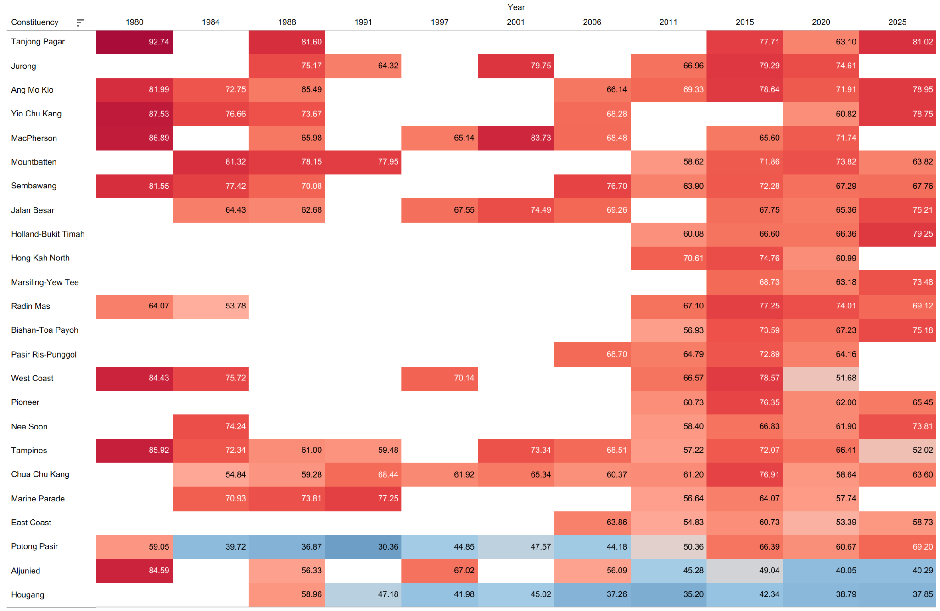
Red is PAP, Blue is Opposition
Notes:
I'm going to give you 20 seconds to just look at this. No narration.
[Pause 20 seconds.]
Okay. What did you notice?
Most of Singapore is deep red. Some of these constituencies have been red for every single election in this dataset without a single break. Tanjong Pagar. Ang Mo Kio. These are PAP fortresses — not because of one good MP, but because of decades of structural dominance.
Now look at the bottom of the heatmap. Hougang. Aljunied. Potong Pasir. The blue appears — but only there. Same small cluster. Same area. Forty years.
This tells you something important. The competitive geography is not spreading. Opposition strength is concentrated and it has stayed concentrated. Point out Potong Pasir
Which means the next strategic question is not "how do we win more seats" — it's "how do we hold and deepen what we already have." The next two slides show you exactly why that question matters so much.

Slide 7
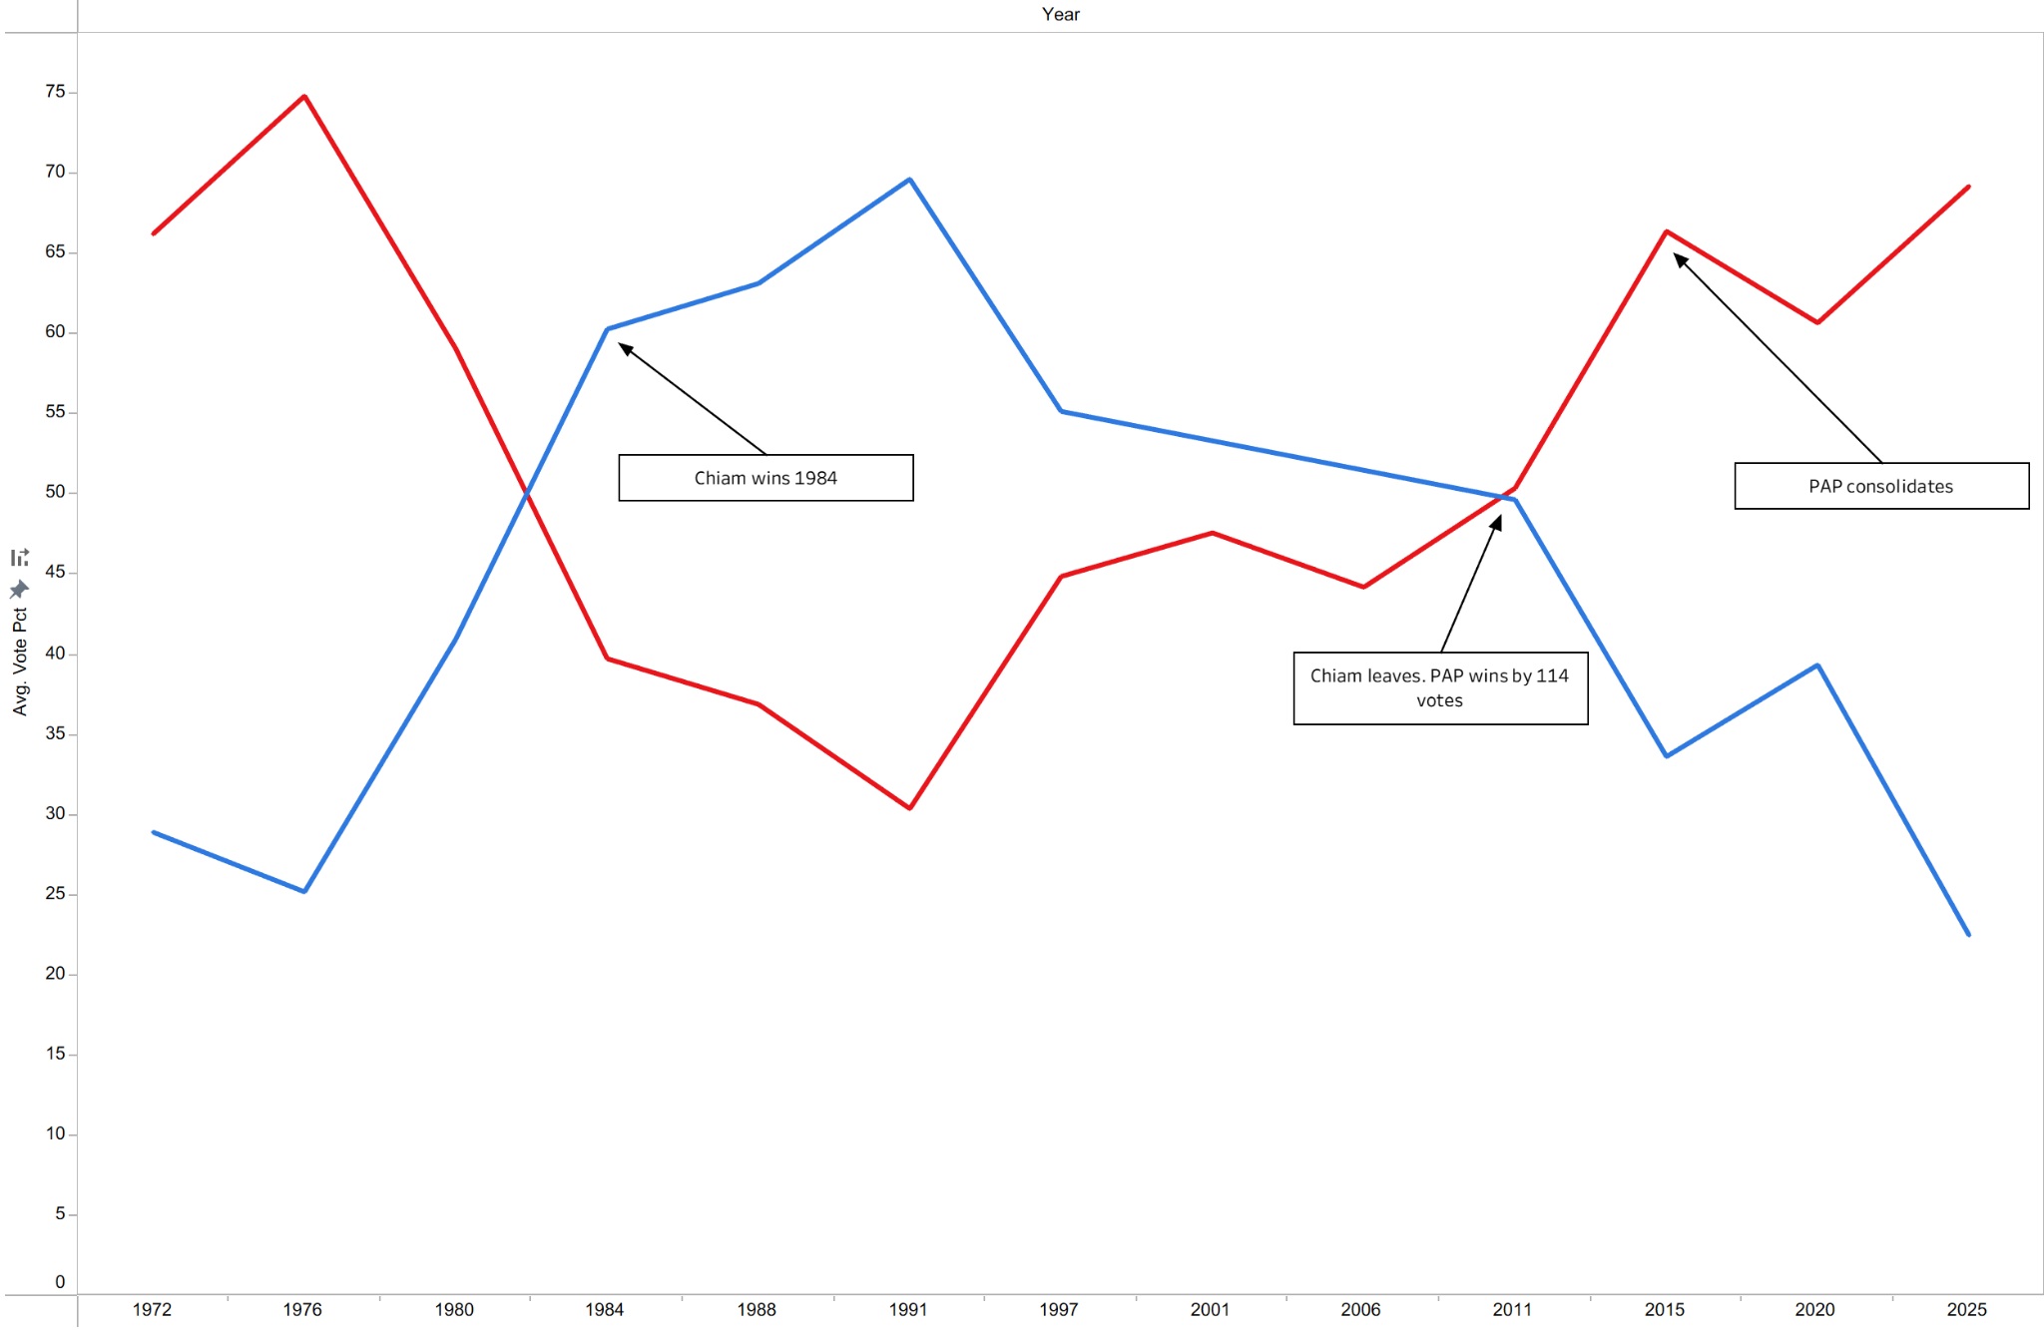
Potong Pasir wasn't lost in 2011.
It was carried by one man — and left with him.
No succession plan
Chiam won 6 consecutive elections. When he left, his wife Lina contested with no independent political identity. PAP vote jumped from 50% to 66% in a single election.
Health reduced ground presence
A 2008 stroke suspended Chiam's weekly Meet-the-People sessions. In Singapore's political culture, constituency presence builds loyalty.
Chiam left, PAP won
In 2011, Chiam steps down and his wife contests in his place. PAP’s vote jumped from 50 to 66%.
Source: Dataset + NLB Infopedia Chiam See Tong
Notes:
Chiam See Tong. Six elections. Twenty-seven years. Potong Pasir.
Look at the chart. First annotation — "Chiam wins 1984." That's the moment opposition support in this constituency went from contested to consistent. The blue line climbs through the 80s and 90s, peaking near 70%. In a political system where most opposition candidates lose their deposits, Chiam was winning by double digits. Residents queued to see him. He showed up every single week.
Then look at the second annotation — "Chiam leaves. PAP wins by 114 votes." One hundred and fourteen votes. That is how narrow the margin was when he stepped down and his wife Lina contested in his place. PAP scraped through by the skin of their teeth.
And then the third annotation — "PAP consolidates." That's the story of every election after. The blue line never recovers. By 2025, PAP is at 69% in Potong Pasir. Twenty-seven years of work. Gone in one term.
What did Chiam actually build over those twenty-seven years? He built loyalty to himself. But he changed parties three times — SDP, SPP, SDA. Every move fragmented the organisational base. When he left, only his personal relationship with residents remained. And personal relationships cannot be handed over.
Personality without institution. That is the cautionary tale.
Now let's see what happens when you build it differently.

Slide 8
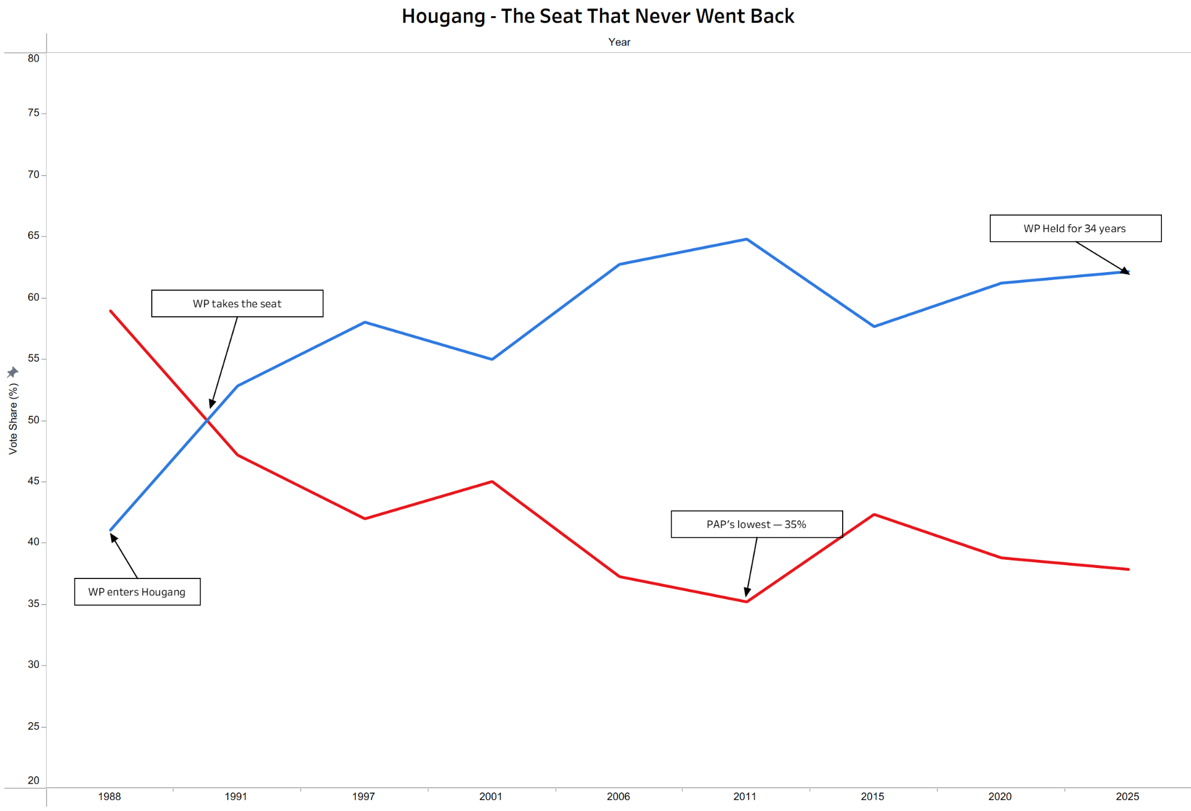
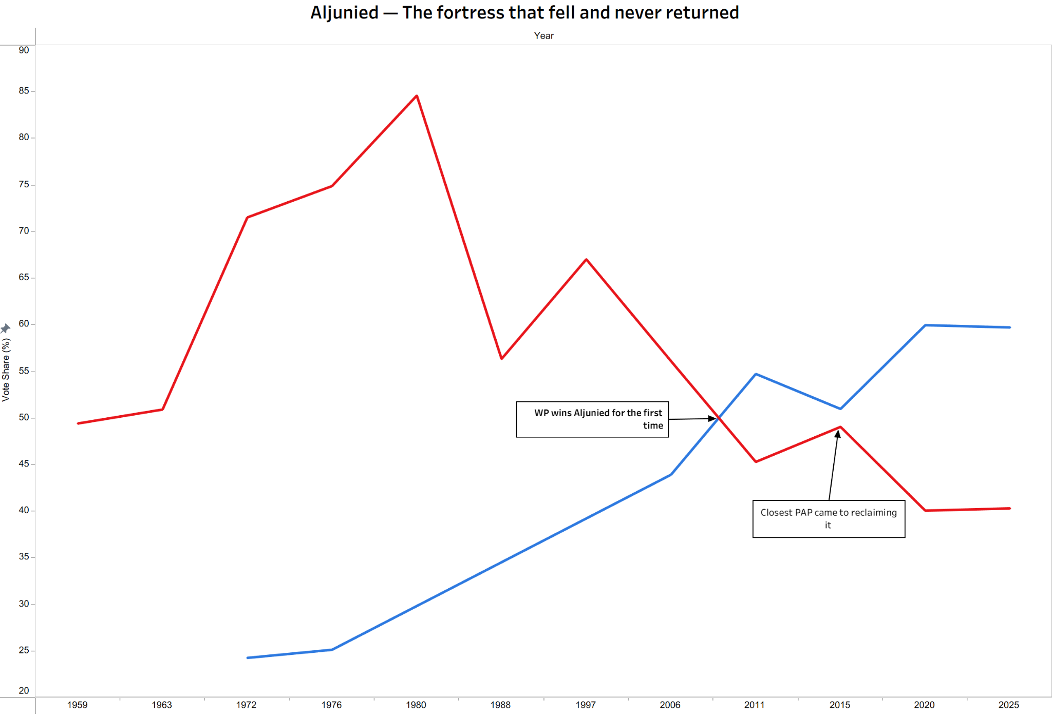
Hougang and Aljunied survived because WP built institutions, not just profiles
Transferred loyalty
The breakthrough
The proof
Low showed up every week for 20 years. When he left, Hougang stayed blue. The community trusted the party — not just the man.
WP lost Aljunied in 2006. They came back anyway. Five years of showing up turned a defeat into a historic win.
After winning, WP got sued and lost access to community spaces. Their majority grew to 20 points anyway.
Notes:
Same era. Same Singapore. Completely different outcome.
Look at the Hougang chart first. Four annotations tell the whole story. "WP enters Hougang" — they start contesting in 1988, lose that first attempt. "WP takes the seat" — 1991, Low Thia Khiang wins. Then "PAP's lowest — 35%" — the point where PAP's support in Hougang bottoms out, showing how deeply WP had embedded itself in the community. And finally — "WP Held for 34 years." Low moved to Aljunied in 2011, a new candidate took over, and the seat never went back.
That is not personal loyalty to one man. That is what an institution looks like.
Now the Aljunied chart. Two annotations. "WP wins Aljunied for the first time" — 2011, after contesting and losing in 2006. Five years of showing up between those two elections, same team, same doors, same community events. They came back and won.
Then — "Closest PAP came to reclaiming it." That's 2015. Here's the context behind that annotation. People's Association blocked WP from community spaces. Town council lawsuit. Months of national press. Every institutional lever that could be pulled — was pulled. And PAP nearly got the seat back.
But look at what happens after that annotation. The WP line climbs. 2020, it jumps sharply. 2025, it holds.
You don't recover like that under that kind of pressure unless the community has decided to trust you as a party — not just as a collection of individuals.

Slide 9
WP has proven it can win.
The question is whether it can scale.
The votes are real
Quality over quantity
PAP's vote share has fallen in 6 of 9 elections since 1984. Opposition support is a sustained trend, not a protest.
WP contests fewer seats than in 1972 but wins more than half of every vote cast against it in those seats.
The barrier is structural
Institutions outlast individuals
The GRC system's real cost is fielding teams — not winning votes. PAP and WP average near-identical shares where WP competes.
Potong Pasir fell when Chiam left. Hougang and Aljunied survived leadership changes because WP built ground presence over decades.
Source: dataset
Notes:
Quick summary before the recommendations.
Forty-year trend — real, structural, not protest. WP strategy — working, quality over quantity confirmed by the data. Barrier — not votes, it's organisational capacity. And institutions — Hougang and Aljunied show they can be built. Potong Pasir shows the cost of not building one.
Three recommendations come directly from these four findings. Let's move through them quickly.

Slide 10
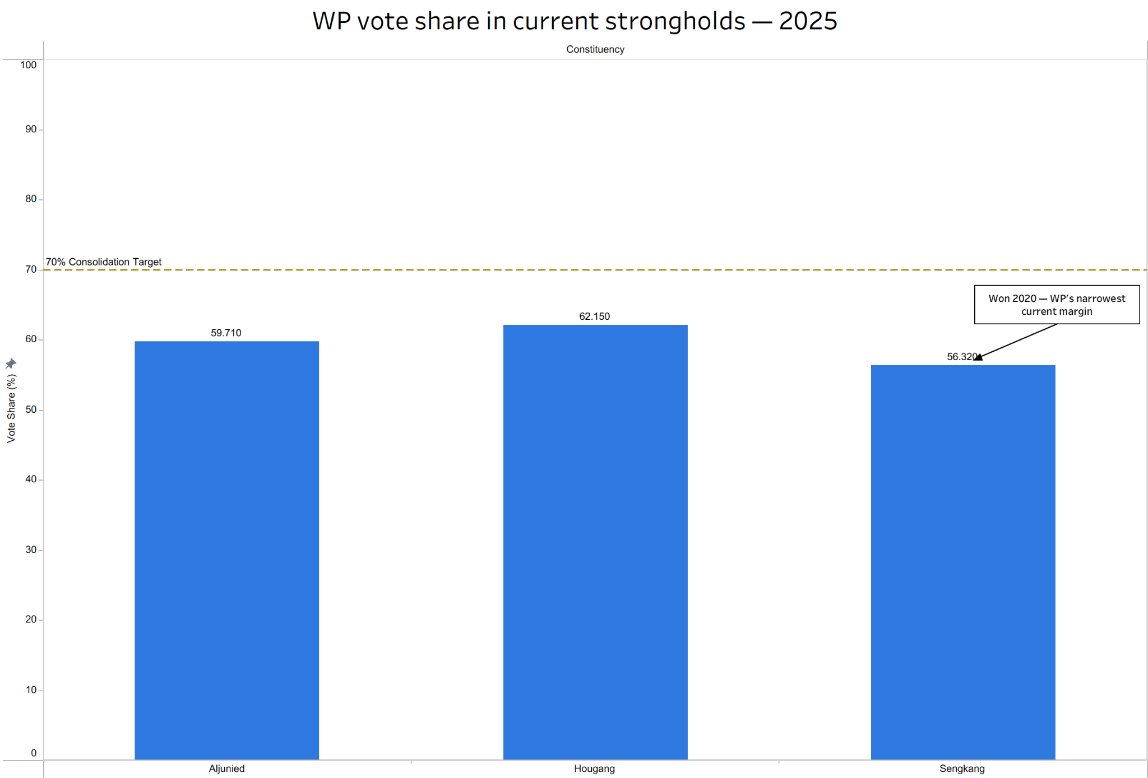
Focus on the 3 strongholds
Why 70%?
Hougang and Aljunied data show that past 60%, PAP recovery becomes difficult. 70% creates a buffer that survives leadership transitions.
Sengkang is vulnerable
Won in 2020 at 52.1% — the narrowest WP margin of any current seat. Without deeper ground investment, a strong PAP push in the next election could reclaim it.
Consolidation frees resources
Securing three unassailable seats reduces defensive spend and frees organisational capacity for selective GRC expansion in the 2030 electoral cycle.
Source: dataset — WP 2025 vote share in contested strongholds
Notes:
First recommendation — and I know it sounds counterintuitive when you have momentum. Don't expand yet.
Look at the chart. Three bars. Hougang 62.2%. Aljunied 59.7%. Sengkang 56.3%. All three sitting below the 70% consolidation target line.
Why 70%? Because the historical data on Hougang and Aljunied shows that once WP crosses 60%, PAP recovery becomes structurally very difficult. 70% gives you a buffer that survives leadership changes, by-elections, and unfavourable national swings.
Now look at the Sengkang bar — it carries the annotation "Won 2020 — WP's narrowest current margin." That annotation is doing a lot of work. Sengkang was won at 52.1% in 2020 and improved to 56.3% in 2025. Progress — but not yet safe. Without deeper ground investment before 2029, it is still genuinely at risk.
And here is the resource logic. Every election cycle WP spends defending Sengkang nervously is a cycle they are not spending building in Tampines or East Coast. In analytics terms — stop putting resources into accounts that are already safe. Focus retention spend on the ones that are actually at churn risk.
Secure the base. Then grow.

Slide 11
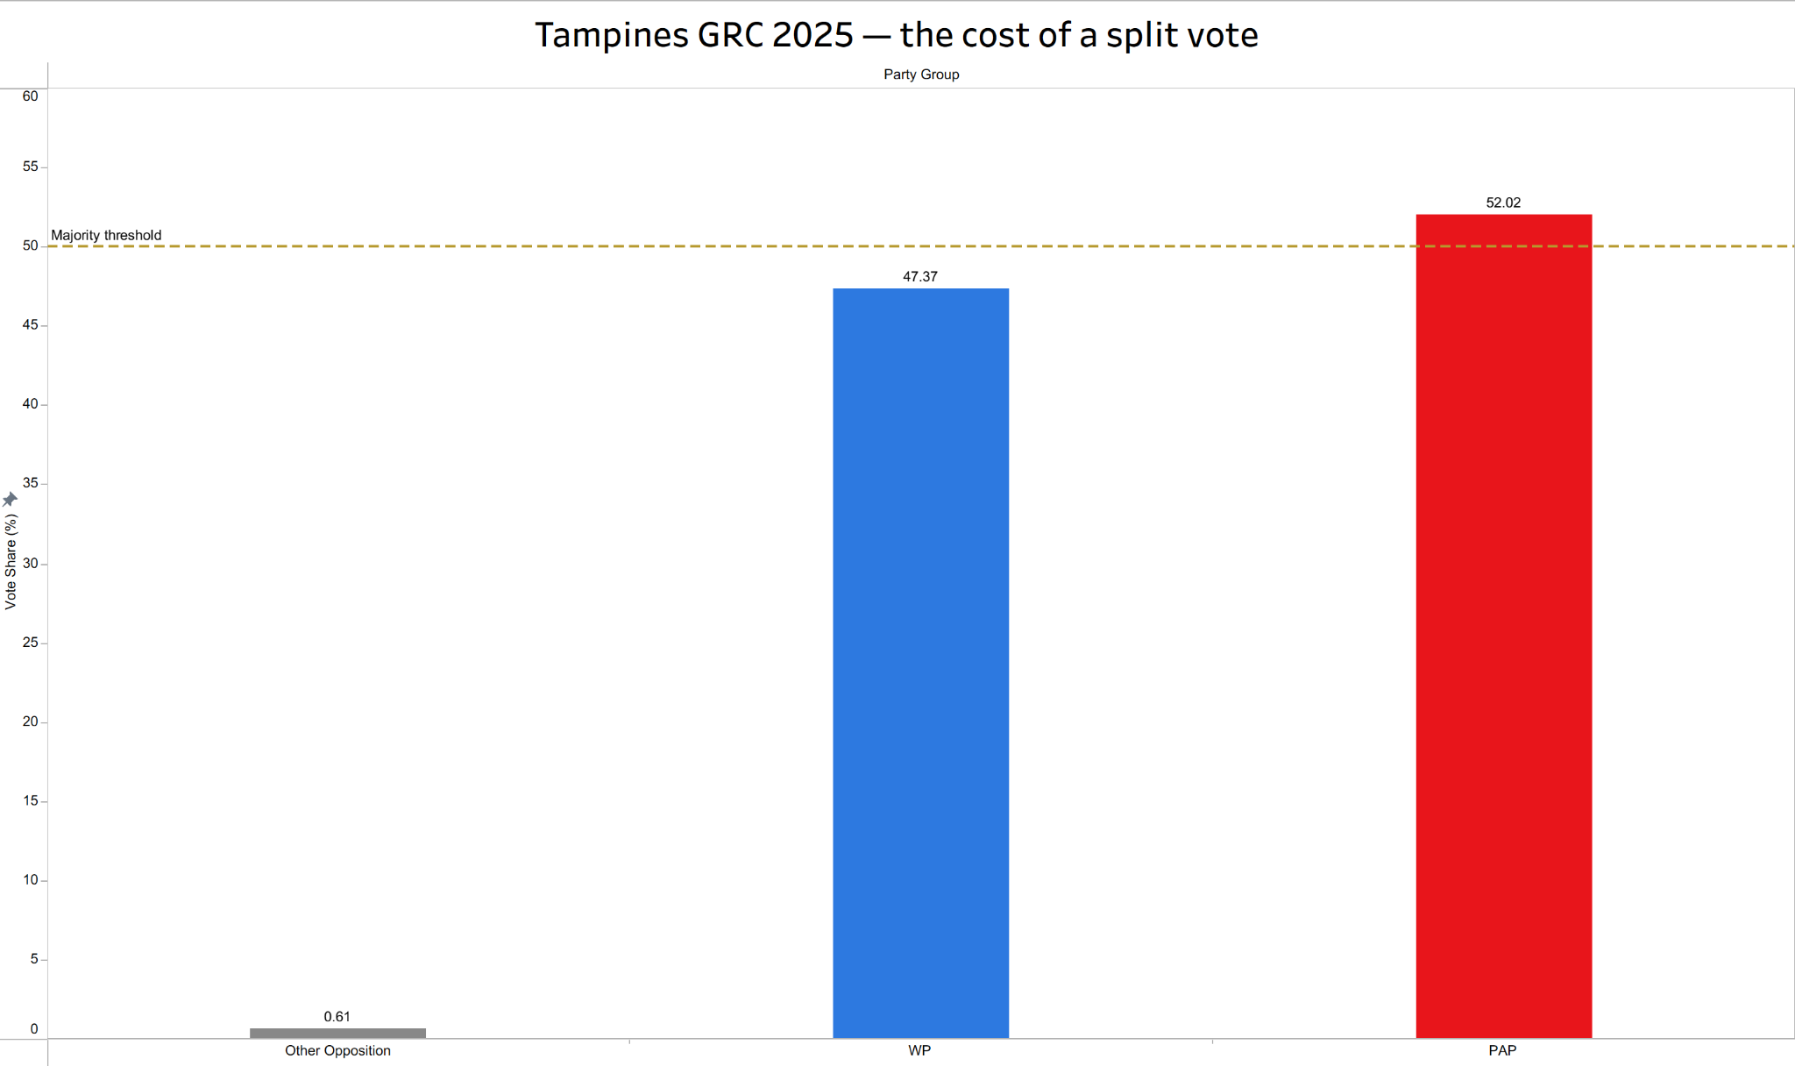
Stop splitting the opposition vote
4 points short
WP + other opposition parties combined for 47.8% of the vote. PAP won with 52.2%. A unified opposition candidate would have made this a genuine contest.
The split cost WP
PPP and NSP took 0.61% between them. Minor party candidates in target seats hand PAP victories they shouldn’t win
The ask
Non-competition agreements in target GRCs. One opposition candidate per seat. The votes are there — they just need to land in one place.
Notes:
Last recommendation. This one is the most straightforward.
Tampines GRC 2025. PAP 52.02%. WP 47.37%. Other opposition parties — PPP and NSP combined — 0.61%.
Add WP and the other opposition together. 47.98%. PAP won by 4 points.
Now look — 0.61% alone didn't cost WP Tampines. I'm not going to overstate that. But the principle scales. Every vote that goes to a minor party with no realistic path to winning in a WP target seat is a vote that does not move the needle. It just makes the margin look slightly less bad in the post-election write-up.
The ask is simple. Non-competition agreements in WP's target GRCs. You don't contest our target seats, we don't contest yours. One opposition candidate per seat. Maximum concentration.
It's the kind of coordination problem that looks obvious from the outside and is apparently very difficult to execute in practice. Which, honestly, is very Singaporean. We can build a whole MRT network but cannot get two opposition parties to agree not to contest the same GRC.
The votes are there. They just need to land in one place.

Slide 12
Singapore's voters are more divided
than its parliament suggests.
The votes are moving. The seats are not.
That gap is Singapore's democratic paradox in 2025.
65.8% votes → 90.6% seats PAP | WP 14.9% votes → 9.3% seats
Lucas Sam · February 2026
Analysis based on 32 constituencies with available historical data. 2025 boundary changes created new constituencies not reflected in this dataset.
Notes:
65.8% of votes. 90.6% of seats. PAP. 14.9% of votes. 9.3% of seats. WP.
The data is clear. The gap is real. And based on forty years of trend data — it is not closing on its own.
Three things need to happen. Consolidate the strongholds. Build the teams. Stop splitting the vote.
None of this requires a policy change. Just organisation, patience, and maybe a bit less kiasu-ness between opposition parties.
Thank you.

